Slide 1


Updated Project Management Process for All External Bureau of Land Management, Nevada National Environmental Policy Act Projects
NV IM 2024-019
Supporting Text
Notes:
Title should state plan name phase of the planning process (DRMP/DEIS; PRMP/FEIS or ROD)
*** Replace title page photo with a map of the planning area (include color legend for the map)

Slide 2


Background
In previous years, BLM NV initiated the NEPA process prior to collecting baseline data and refining applications, plans of operation, or plans of development.
This method resulted in lengthy NEPA analyses often lasting years.
In response, BLM NV created efficiencies in by implementing a robust “pre-NEPA” process.
Since BLM NV implemented this process in NV IM 2023-003 Change 1, project outcomes improved and NEPA timelines shortened.
Over time, BLM NV further improved, refined, and clarified its process which is published in this updated Instruction Memorandum (BLM NV IM 2024-019).

Slide 3
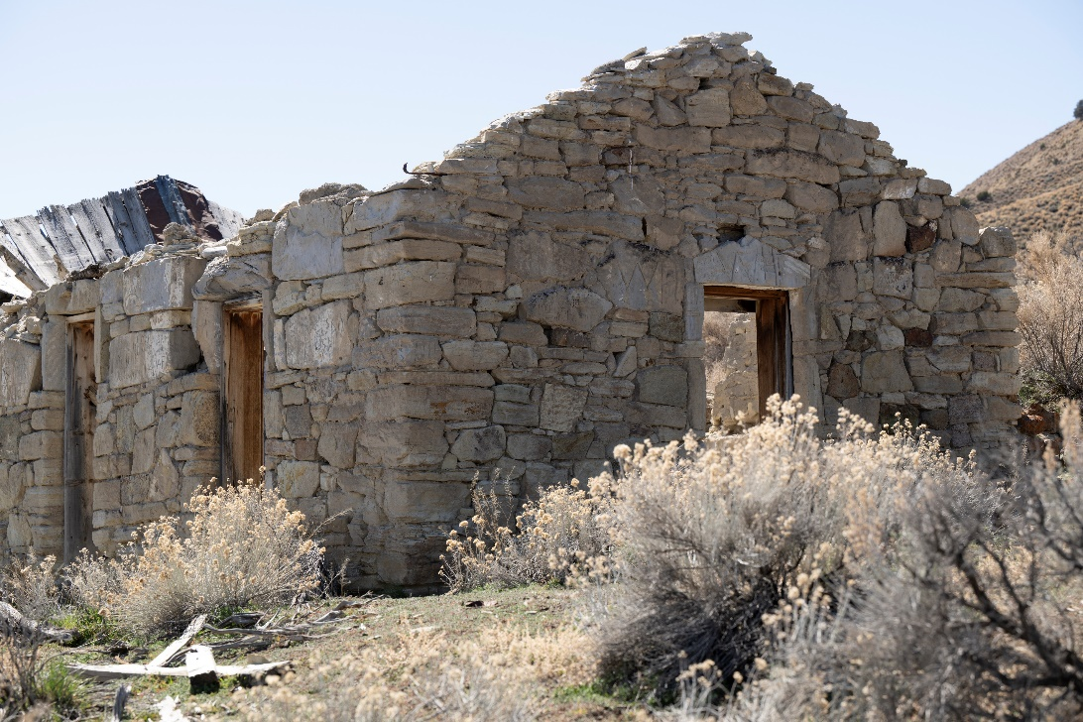
The BLM NV Process
Hallmark is robust pre-NEPA work prior to initiating the official NEPA process:
Collection of baseline data
Refinement of applications, plans of operation/development
Drafting of Supplemental Information Report (SIR) and Supplemental Environmental Reports (SERs)
Drafting Biological Assessment (if practicable)
Challenges:
Multiple triggers starting the NEPA clock
Language nuances “proposed plan” & “received” vs “accept”
Educating proponents of the advantages of the process
Familiarizing stakeholders with the pre-NEPA process
Advantages of robust pre-NEPA:
Shorter NEPA time.
Fewer “go backs” during or after NEPA.
Better meets spirit and intent of NEPA.
Notes:
Start with local counties and state gov’t, then list others. Talk about (don’t write) what was important in scoping/public comments. Identify cooperating agencies. Identify if they were favorable to the preferred alt.

Slide 4

Process Highlights
Phase 1: Before Baseline Studies Begin
Conversation with proponent.
Project proponent submits draft application (APP), plan of operation (POO), or plan of development (POD).
AO begins pre-NEPA within 90 days of accepting a draft APP/POO/POD.
Conduct pre-NEPA kick off meeting with affected parties
Baseline Needs Assessment Form (BNAF) completed
Cost Recovery Agreement signed
Proponent begins collection of baseline data.
Phase 2: After Baseline Studies are Complete
When baseline studies are complete then…
Drafting of Supplemental Information Report (SIR) and Supplemental Environmental Reports (SERs) begin.
BLM/USFWS enter into formal consultation agreement.
BLM enters into formal Cooperating Agency (CA) agreements (with MOUs).
Proponent refines APP/POO/POD
Prepare APP/POO/POD for finalization
Begin drafting Biological Assessment (BA), if practicable
Conduct Initial Action Notice (IAN) briefing with HQ.
Prepare Notice of Intent (NOI)
Start of NEPA
Publish NOI to Federal Register (NV IM 2024-020)
BLM accepts APP/POO/POD as complete.
IM currently underway…

Slide 5
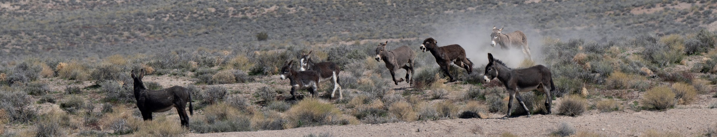
Start and Stop of NEPA Clock
For EIS
Date of NOI
OR
Date of letter notifying proponent of:
Acceptance of APP/POO/POD
Level of NEPA
Ideally, synchronize the dates.
For EA
Date of letter notifying proponent of:
Acceptance of APP/POO/POD
Level of NEPA
OR
At the start of public involvement for an EA at either scoping or at public review.
Ideally, synchronize the dates.

Slide 6

Page and Time Limitations
For EIS
1 year (2 years statutory)
Time extensions permitted if approved
150 pages (300 if complex and approved)
No exceptions allowed
For EA
6 months (1 year statutory)
Time extensions permitted if approved
75 pages
No exceptions allowed

Slide 7
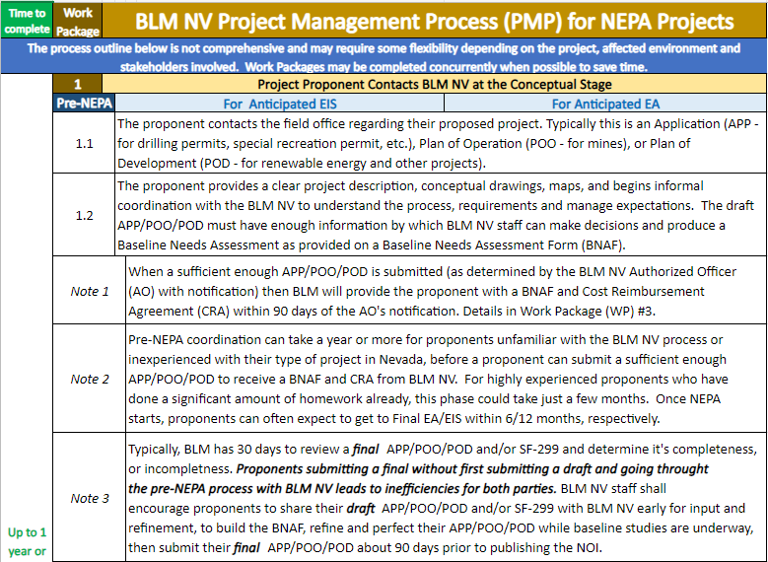
NV IM 2024-024 Updated Project Management Process for All Internal BLM NV NEPA Projects, Attachment 1 – Project Management Process

Slide 8
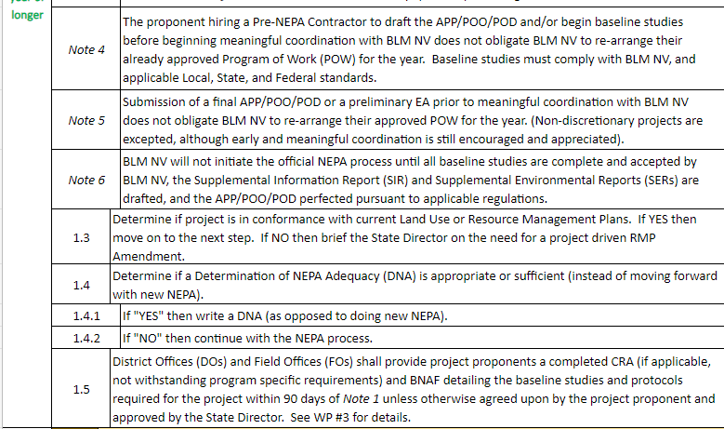

Slide 9
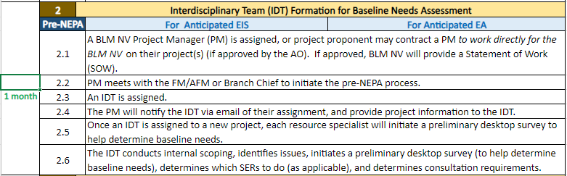



Slide 10
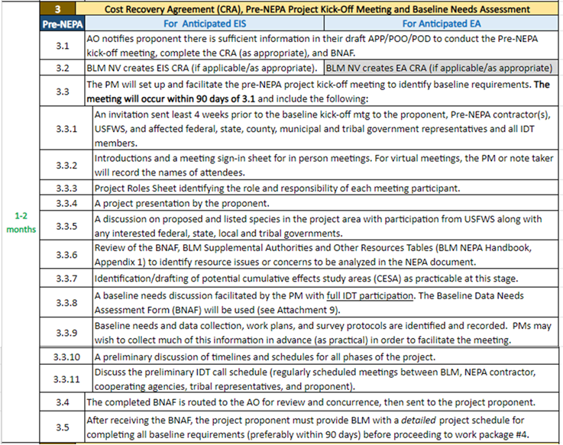

Slide 11
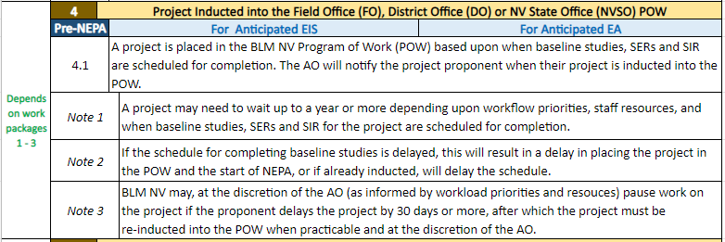


Slide 12
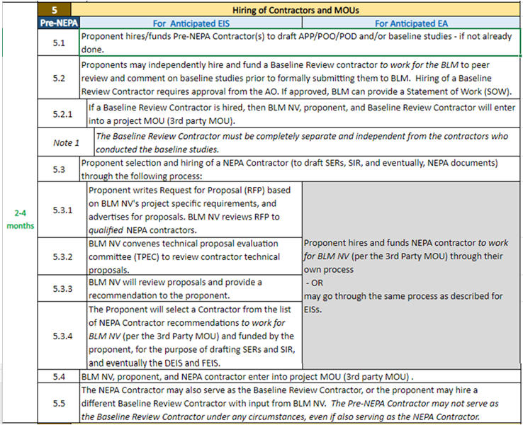

Slide 13
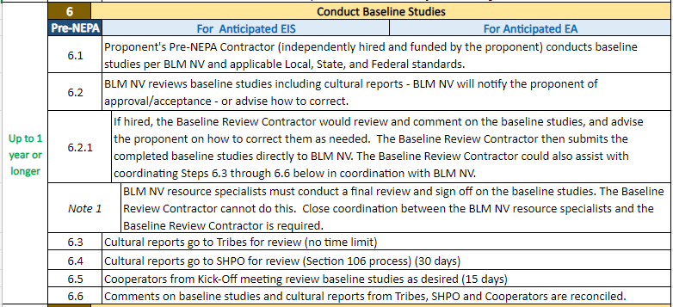

Slide 14
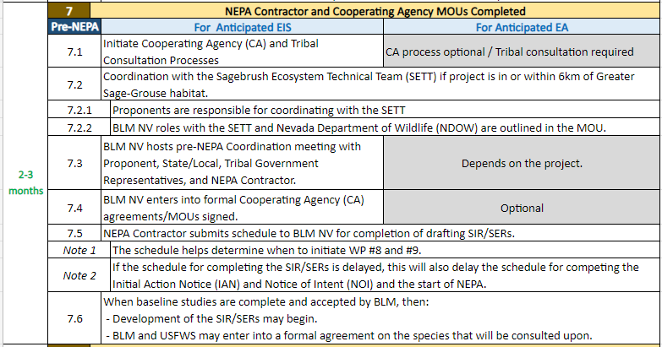

Slide 15
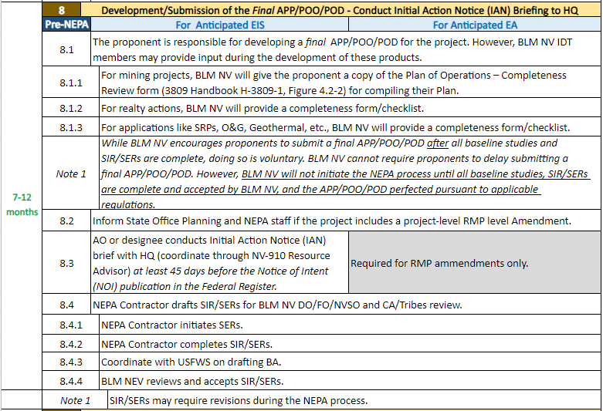

Slide 16
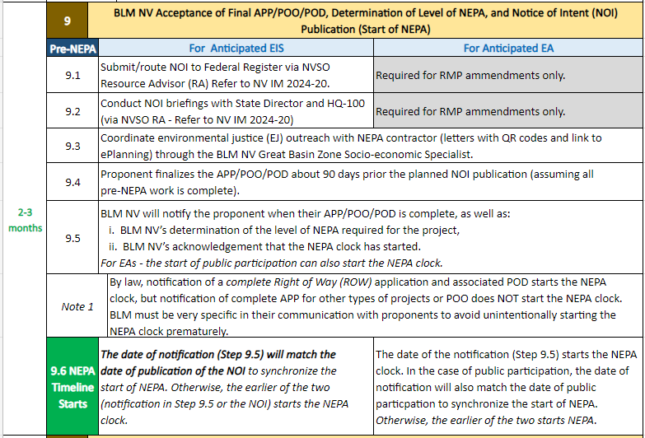

Slide 17
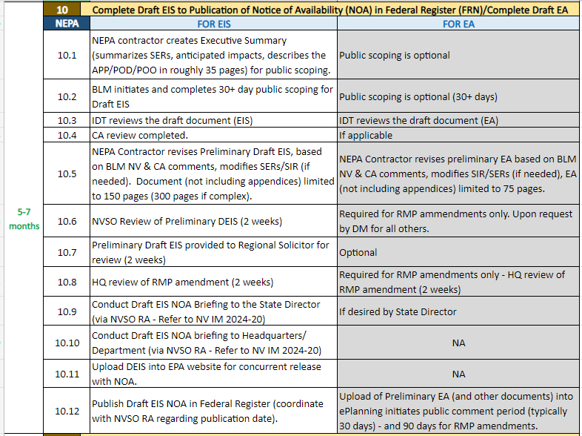

Slide 18
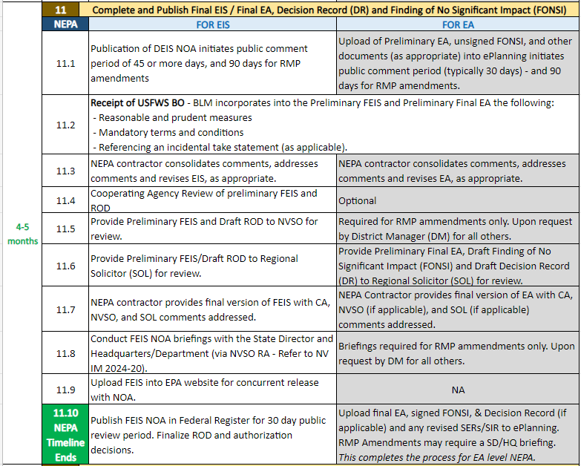

Slide 19
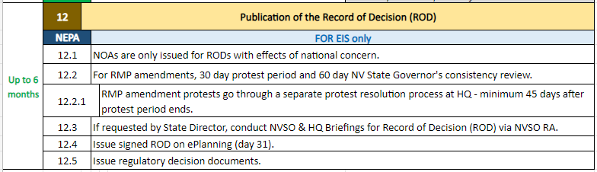
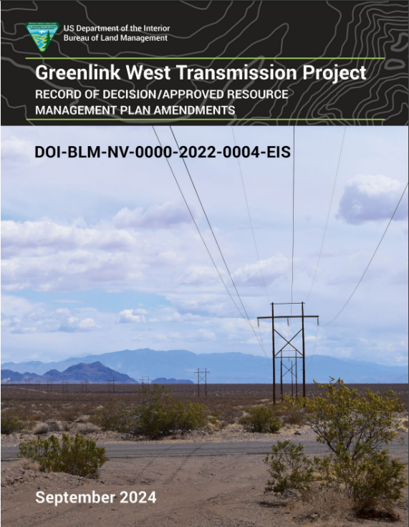
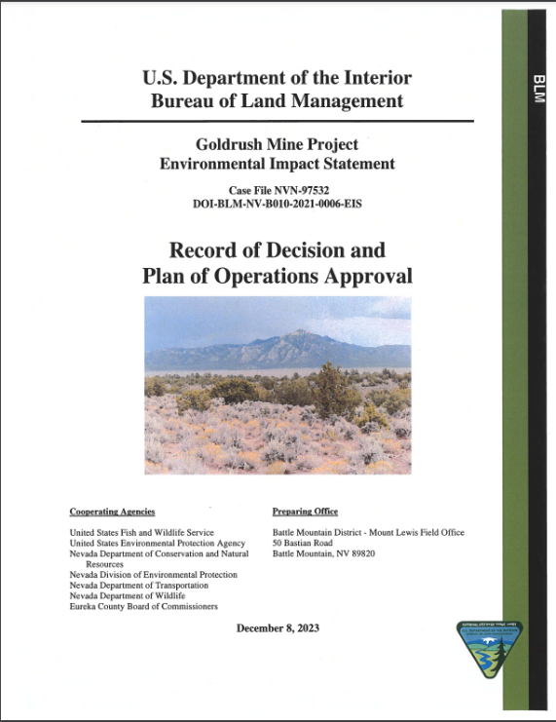
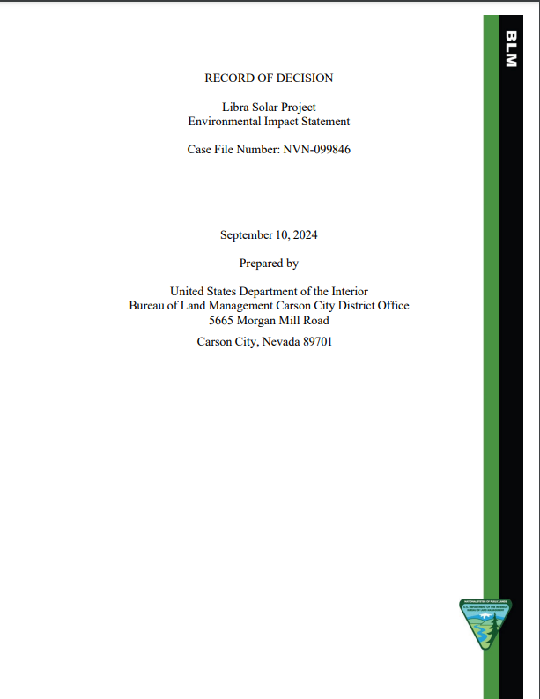

Slide 20

Questions/Discussion

